Slide 1
Tutorial Machine Learning in Solid Mechanics
Task 3: Viscoelasticity
Xin Xiong ,Huasen Luo
February 4, 2025

Slide 2
Agenda
1
Data generation
2
Simple RNN
3
Maxwell model
4
Generalized standard materials (GSM) model
5
Results
6
Conclusion

Slide 3
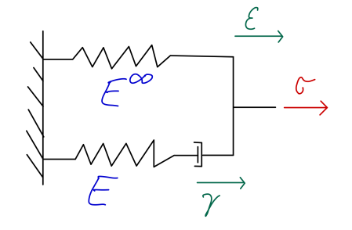
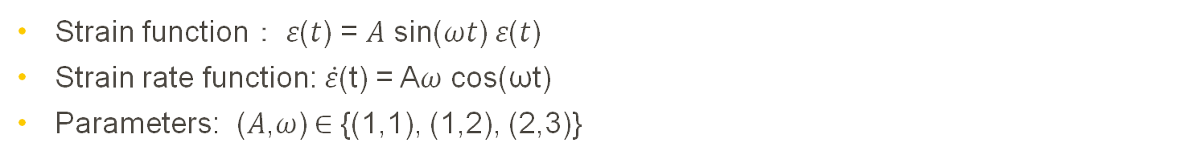
1 Data Generation
Harmonic Oscillation
Strain function： 𝜀(𝑡) = 𝐴 sin(𝜔𝑡) 𝜀(𝑡)
​Strain rate function: $\dot{\text{ε}}$(t) = A𝜔 cos(ωt)
Parameters: (𝐴,𝜔) ∈ {(1,1), (1,2), (2,3)}
Relaxation Tests
Strain applied until first peak, then fixed to observe stress relaxation

Slide 4
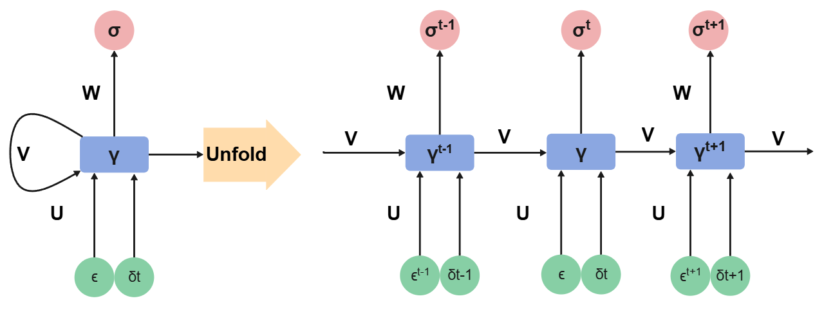
2 Simple RNN
Notes:
Results of calibrating the naive neural network using the biaxial test dataset.

Slide 5
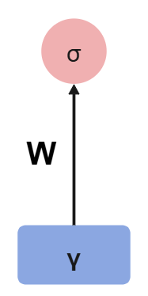
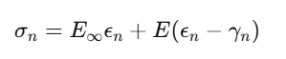

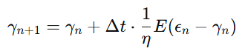
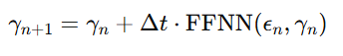
3 Maxwell model
Maxwell model (not trainable)
Maxwell model (trainable)
Notes:
Results of calibrating the naive neural network using the biaxial test dataset.

Slide 6
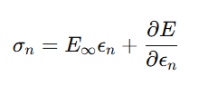
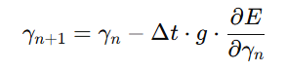
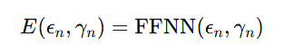
4 Generalized standard materials model
Notes:
Results of calibrating the naive neural network using the biaxial test dataset.

Slide 7
6 Conclusion
Model | How Physics is Incorporated
Simple RNN | No physics, purely data-driven.
Maxwell Model | Directly uses Maxwell equation constraints.
GSM Model | Uses neural network to approximate physical energy functions.

Slide 8
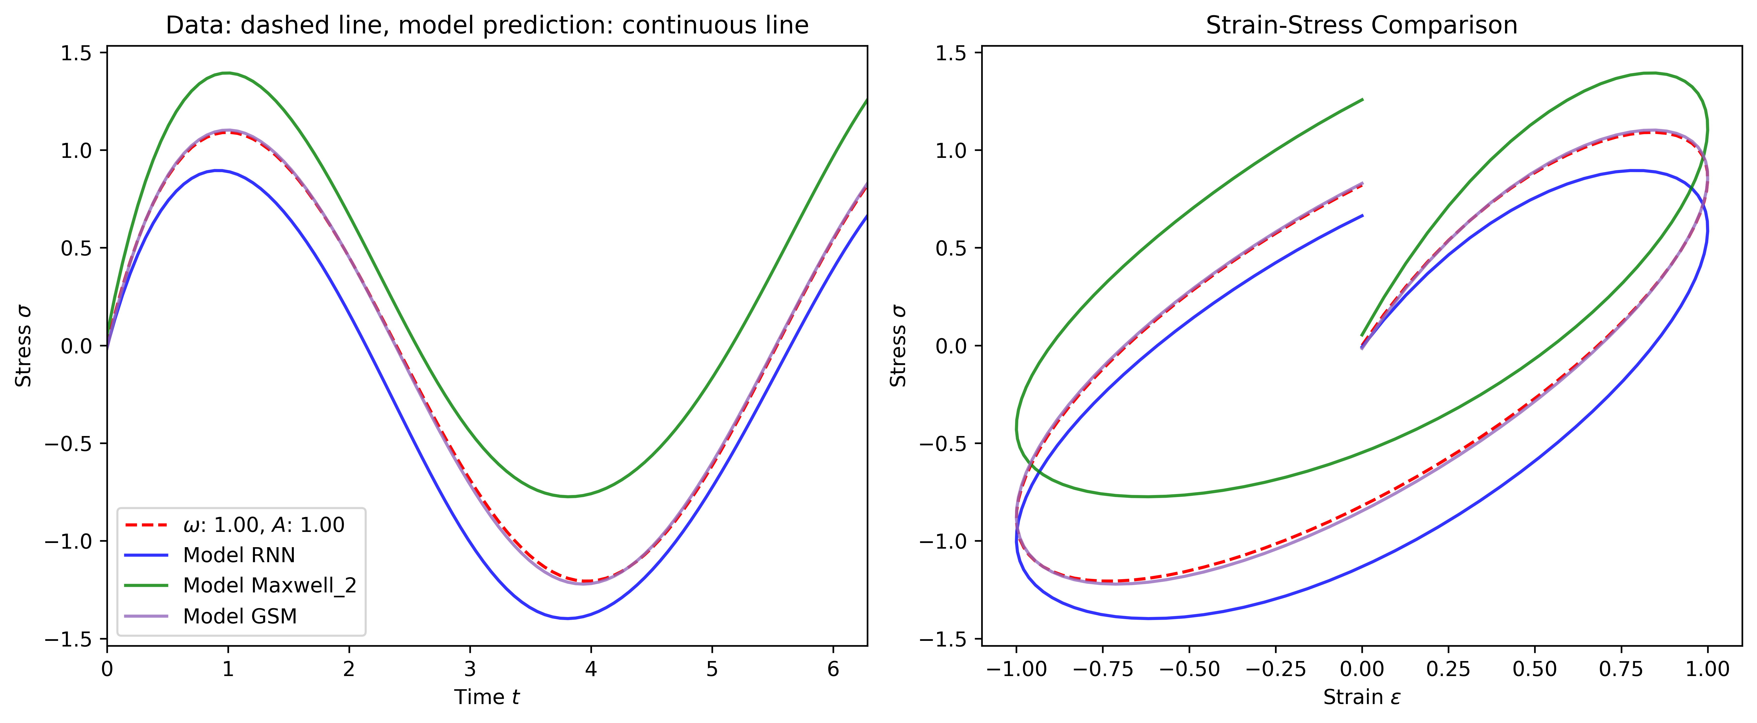
5 Results
Interpolation ability
Train on ω=2 A=2 Test on ω=1 A=1
Notes:
Results of calibrating the naive neural network using the biaxial test dataset.

Slide 9
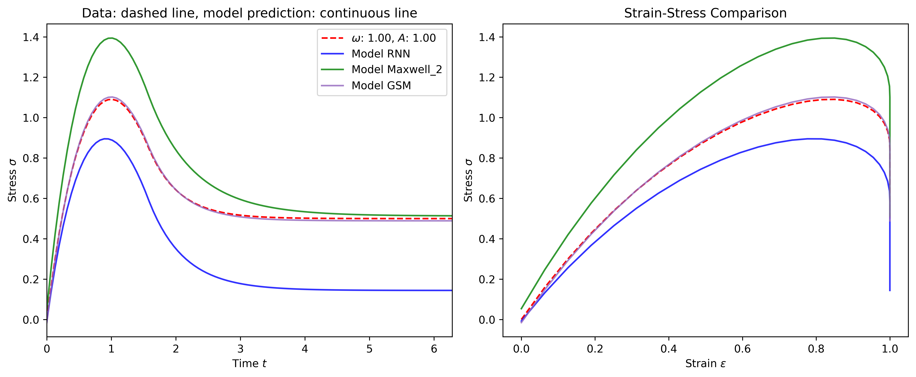
5 Results
Interpolation ability
Train on ω=2 A=2 Test on ω=1 A=1
Notes:
Results of calibrating the naive neural network using the biaxial test dataset.

Slide 10
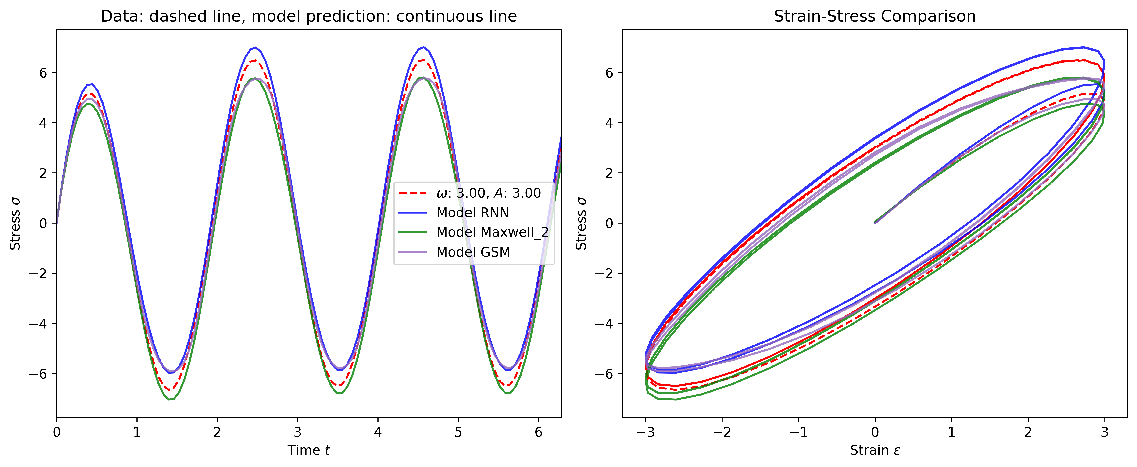
5 Results
Extrapolation ability
Train on ω=2 A=2 Test on ω=3 A=3
Notes:
Results of calibrating the naive neural network using the biaxial test dataset.

Slide 11
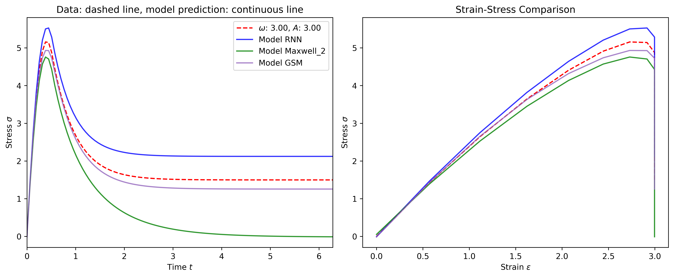
5 Results
Extrapolation ability
Train on ω=2 A=2 Test on ω=3 A=3
Notes:
Results of calibrating the naive neural network using the biaxial test dataset.

Slide 12
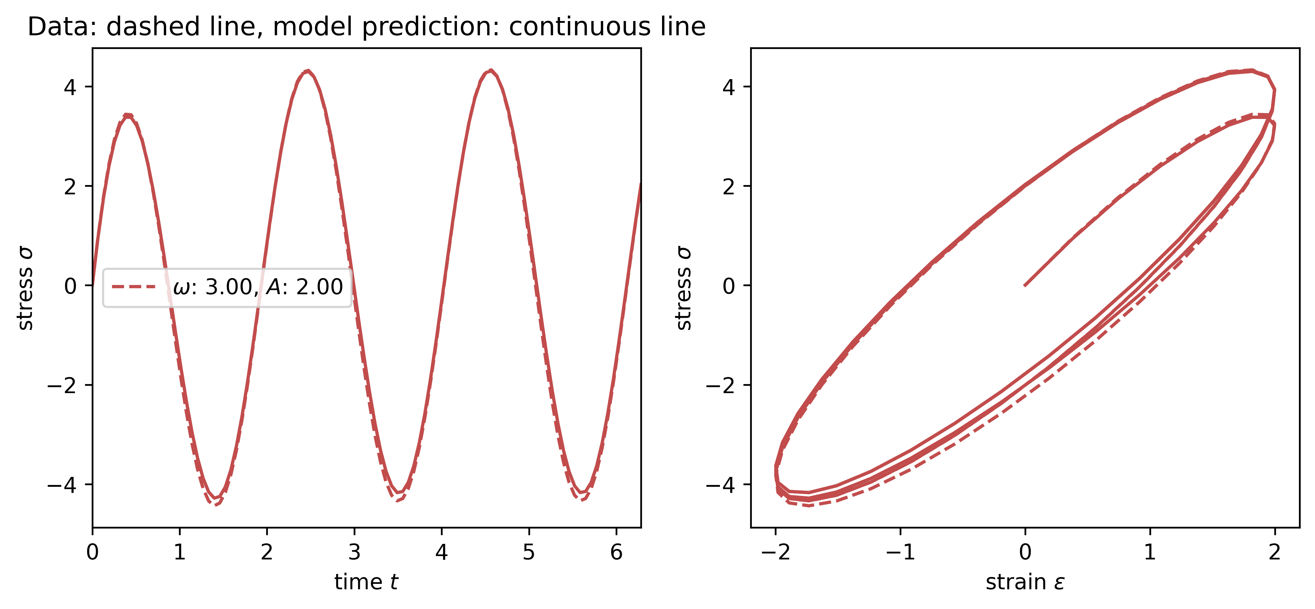
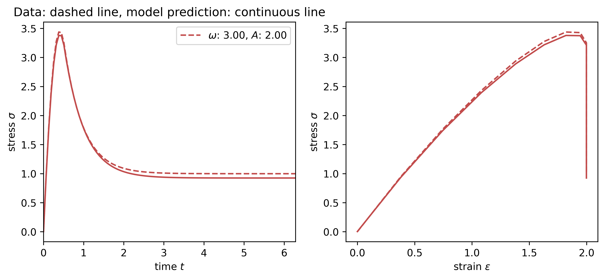
5 Results
Load path
Use Harmonic dataset
Notes:
Results of calibrating the naive neural network using the biaxial test dataset.

Slide 13
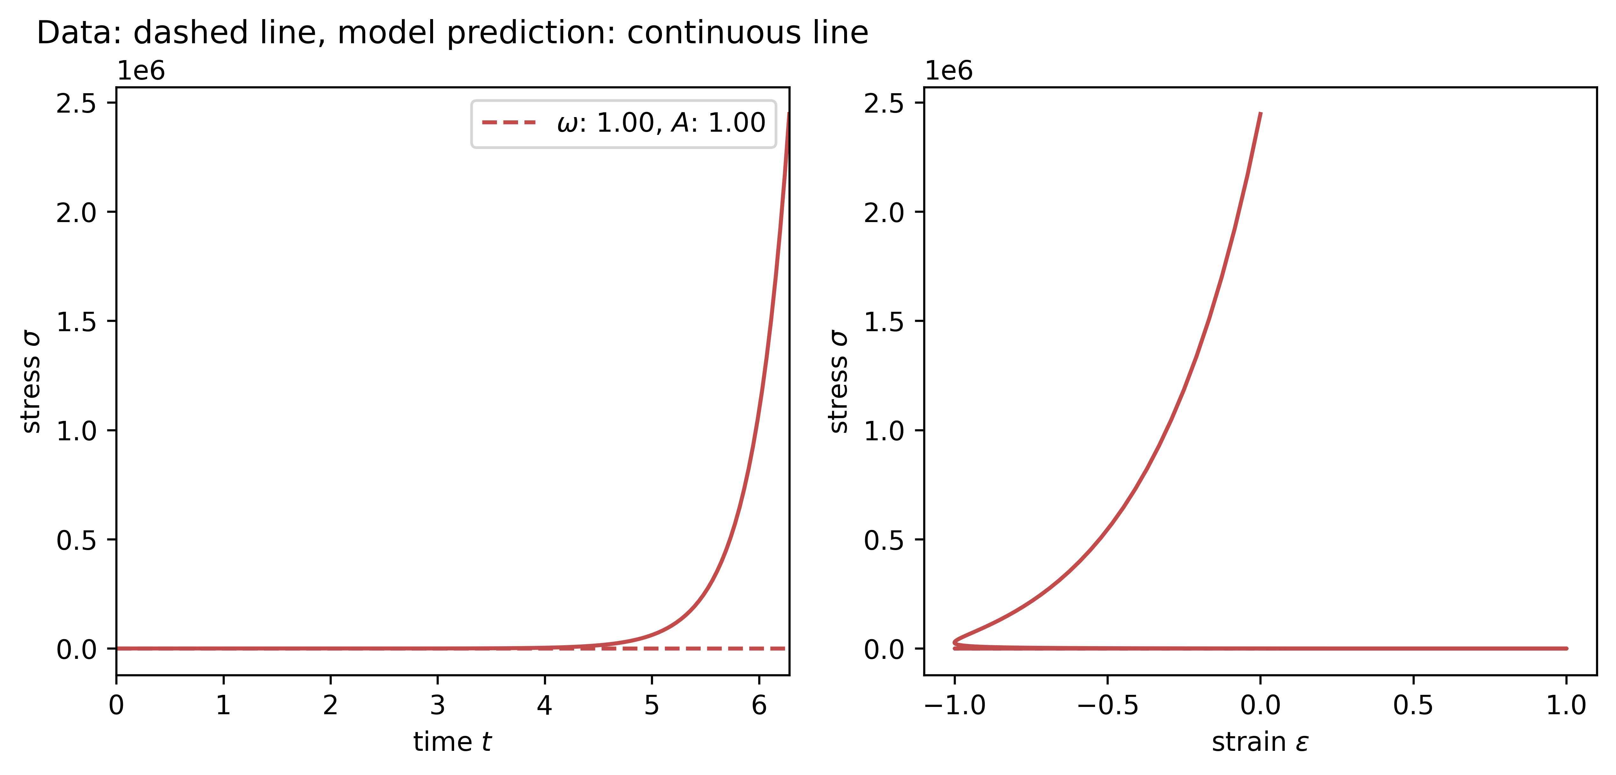
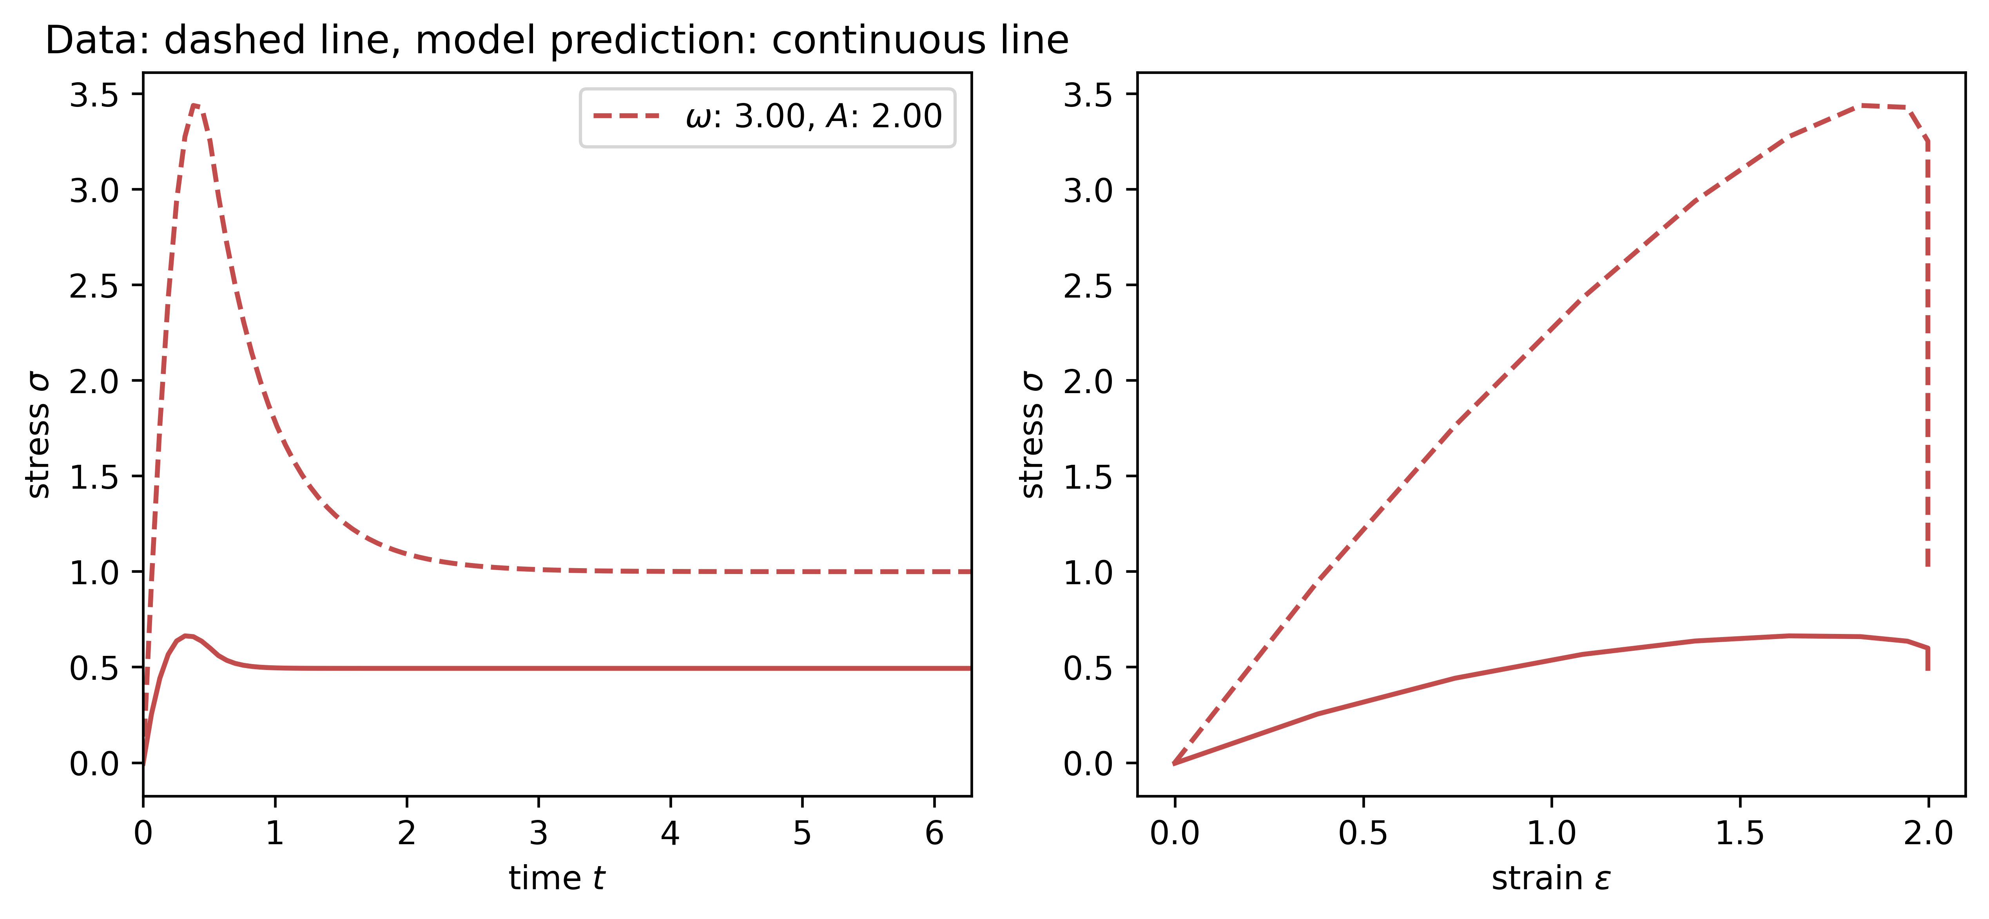
5 Results
Load path
Use relaxation dataset
Notes:
Results of calibrating the naive neural network using the biaxial test dataset.

Slide 14
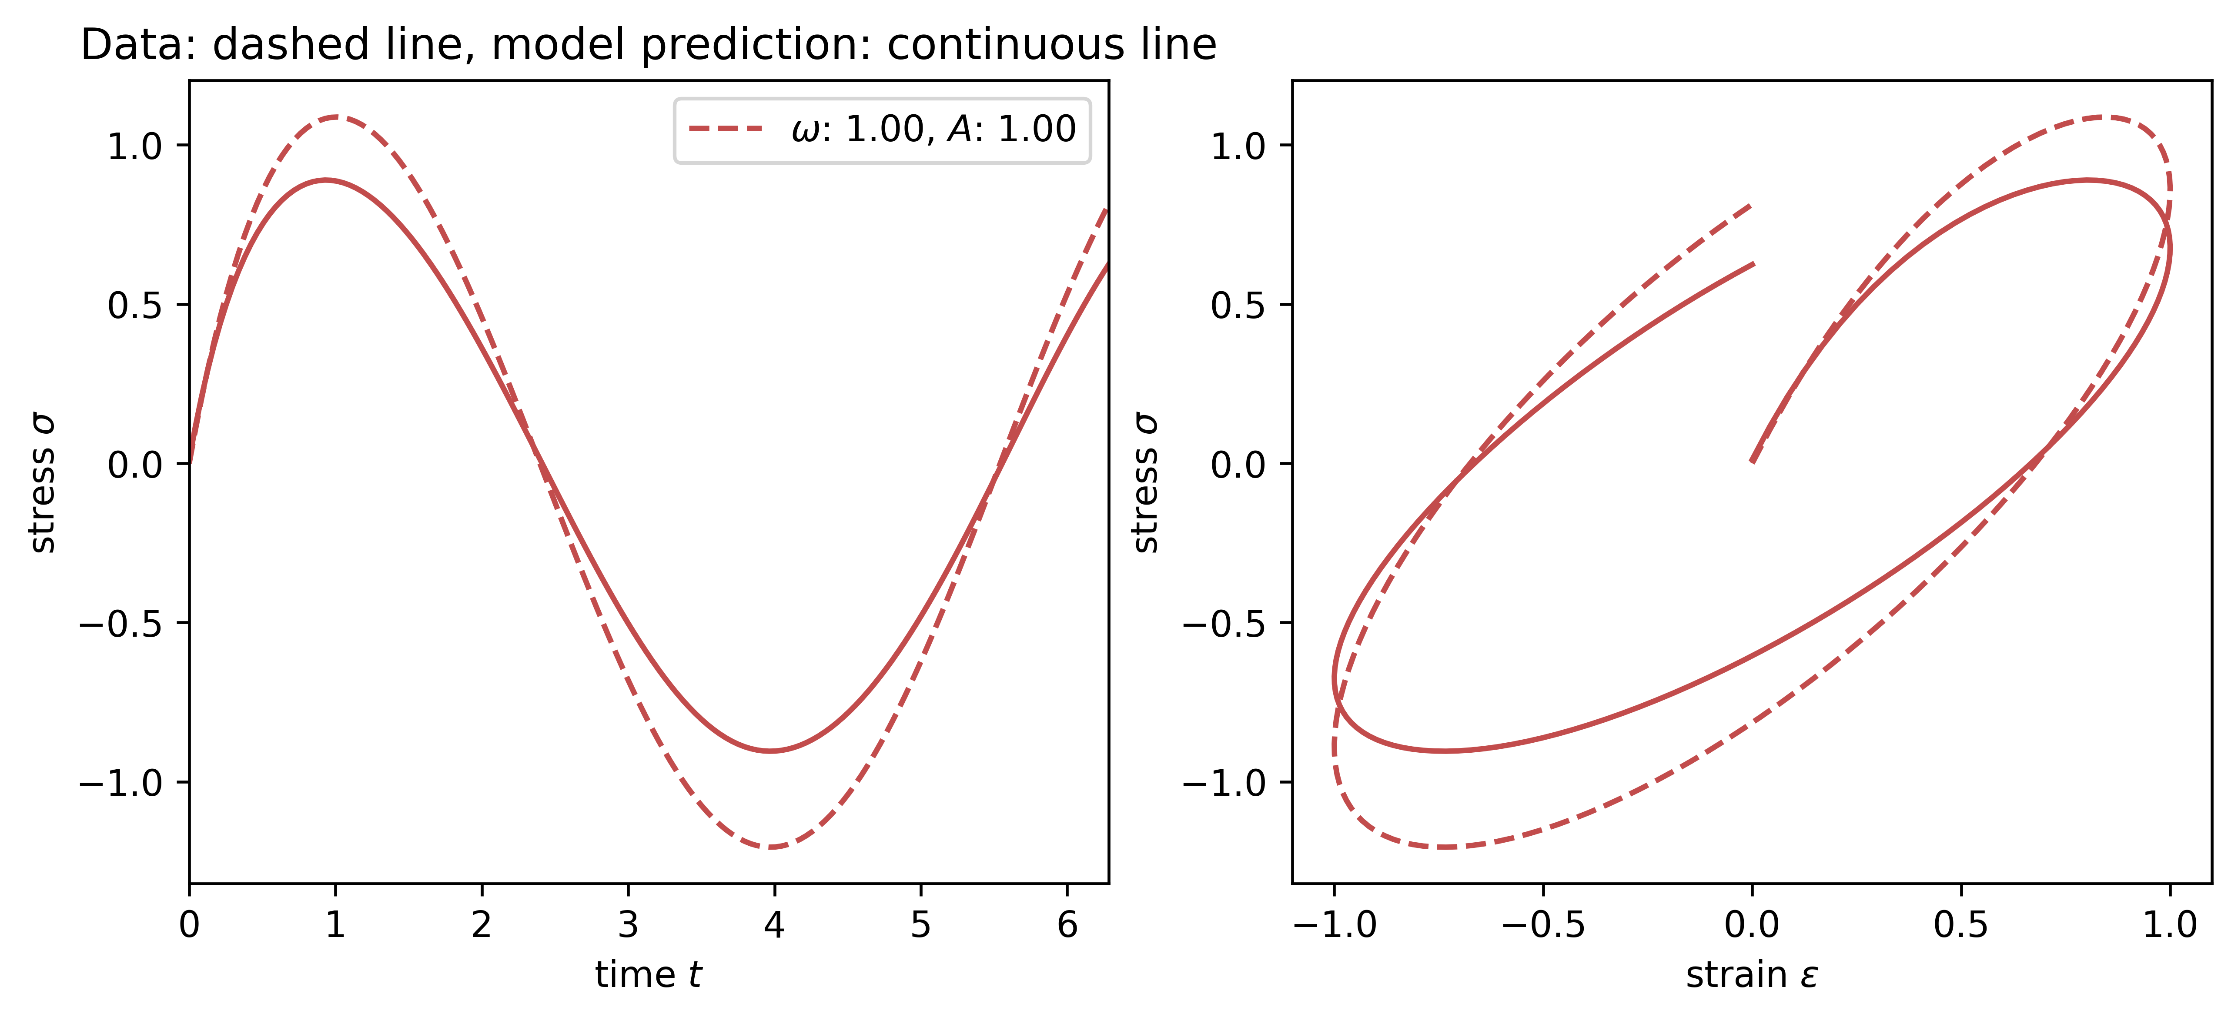
5 Results
Change n=150 for RNN model
Notes:
Results of calibrating the naive neural network using the biaxial test dataset.

Slide 15
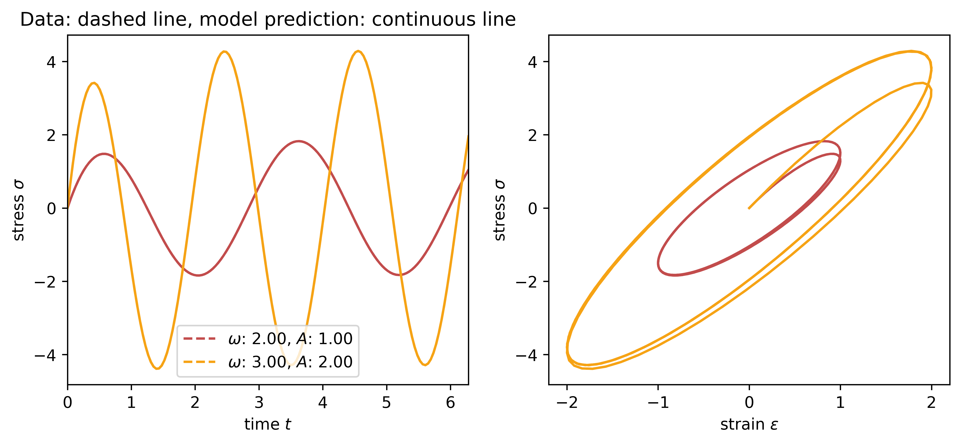
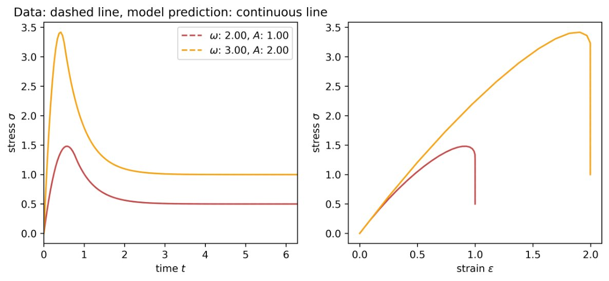
5 Results
Maxwell model (not trainable)
Test on ω=2 A=1 and ω=3 A=2
Notes:
Results of calibrating the naive neural network using the biaxial test dataset.

Slide 16
6 Conclusion
Feature | Simple RNN | Maxwell Model | GSM Model
Physics-based? | No | Yes | Yes
Training Approach | Purely Data-driven | Physics + Data | Physics + Neural Network
Computational Cost | Low | Moderate | High
Interpolation | Good | Good | Best
Extrapolation | Good | Good | Best
Notes:
Simple RNN is weak in generalization.简单 RNN 的泛化性较弱。Maxwell Model balances physics and data.Maxwell 模型平衡物理场和数据。GSM Model offers the best performance but is computationally expensive.GSM 模型提供最佳性能，但计算成本高昂。

Slide 17
Danke
Xin Xiong, Huasen Luo

